Slide 1
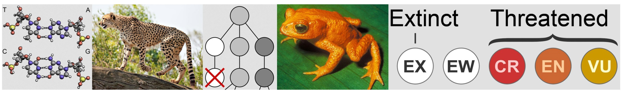

Biol3110: Conservation and Ecological genetics
Tutorial 3
First hour: More advanced quantitative genetics questions
Second hour: Revision

Slide 2
TEST NEXT WEEK
1.5 hr duration
Online
Only deals with tute and lecture material to date
Open Book
Multiple Choice

Slide 3
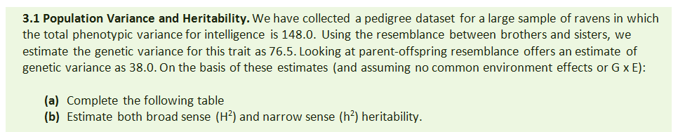
V_{A}
V_{D + I}
V_{G}
V_{E}
V_{P}
We need to use:
V_{P} = V_{G} + V_{E}
V_{G} = V_{A} + [V_{D +} V_{I}]
V_{P} = [V_{A} + V_{D +} _{I}] + V_{E}

Slide 4
V_{A} | 38.0
V_{D + I}
V_{G} | 76.5
V_{E}
V_{P} | 148.0
We need to use:
V_{P} = V_{G} + V_{E}
V_{G} = V_{A} + [V_{D +} V_{I}]
V_{P} = [V_{A} + V_{D +} _{I}] + V_{E}

Slide 5
V_{A} | 38.0
V_{D + I} | 38.5
V_{G} | 76.5
V_{E} | 71.5
V_{P} | 148.0

Slide 6
V_{A} | 38.0
V_{D + I} | 38.5
V_{G} | 76.5
V_{E} | 71.5
V_{P} | 148.0
H² = V_{G} / V_{P}
= 76.5 / 148
= 0.517
h² = V_{A}/ V_{P}
= 38 / 148
= 0.257

Slide 7
Draw a
V_{A} | 38.0
V_{D + I} | 38.5
V_{G} | 76.5
V_{E} | 71.5
V_{P} | 148.0

Slide 8
Draw a
V_{A} | 38.0
V_{D + I} | 38.5
V_{G} | 76.5
V_{E} | 71.5
V_{P} | 148.0
V_{P} = 148.0

Slide 9
Draw a
V_{A} | 38.0
V_{D + I} | 38.5
V_{G} | 76.5
V_{E} | 71.5
V_{P} | 148.0
V_{E} = 71.5
V_{G} = 76.5
V_{P} = 148.0
= V_{G} + V_{E}

Slide 10
Draw a
V_{A} | 38.0
V_{D + I} | 38.5
V_{G} | 76.5
V_{E} | 71.5
V_{P} | 148.0
V_{E} = 71.5
V_{D+I} = 38.5
V_{p}
V_{G}
V_{A} = 38.0
V_{P} = 148.0
= V_{G} + V_{E}
= V_{A} + V_{D+I} + V_{E}

Slide 11
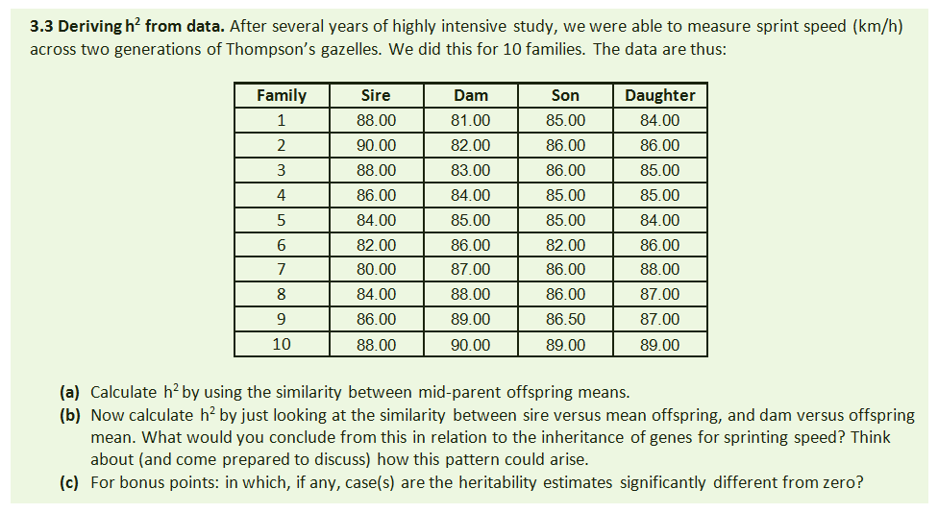

Slide 12
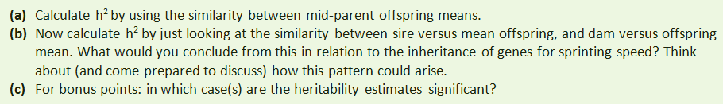
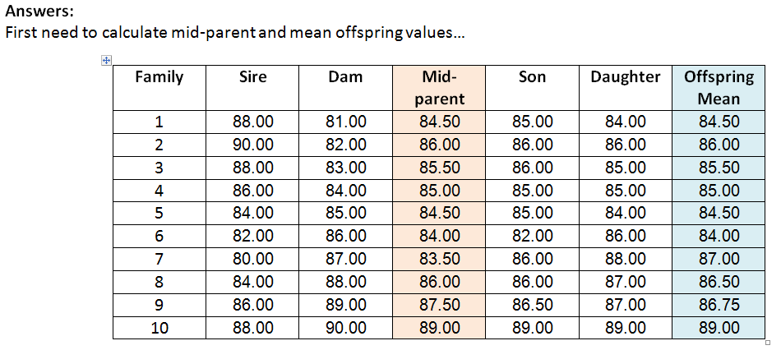

Slide 13

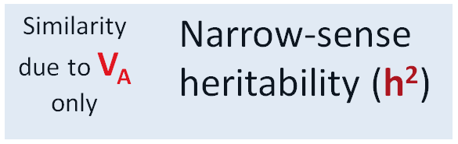
Estimating heritability:
If the environments are standardized, then:
Similarity of parents & offspring:
Calculated directly as the slope of a regression of midparent values (x) against offspring mean values (y). Slope calculated by rise/run.
Examples…
Father Son

Slide 14
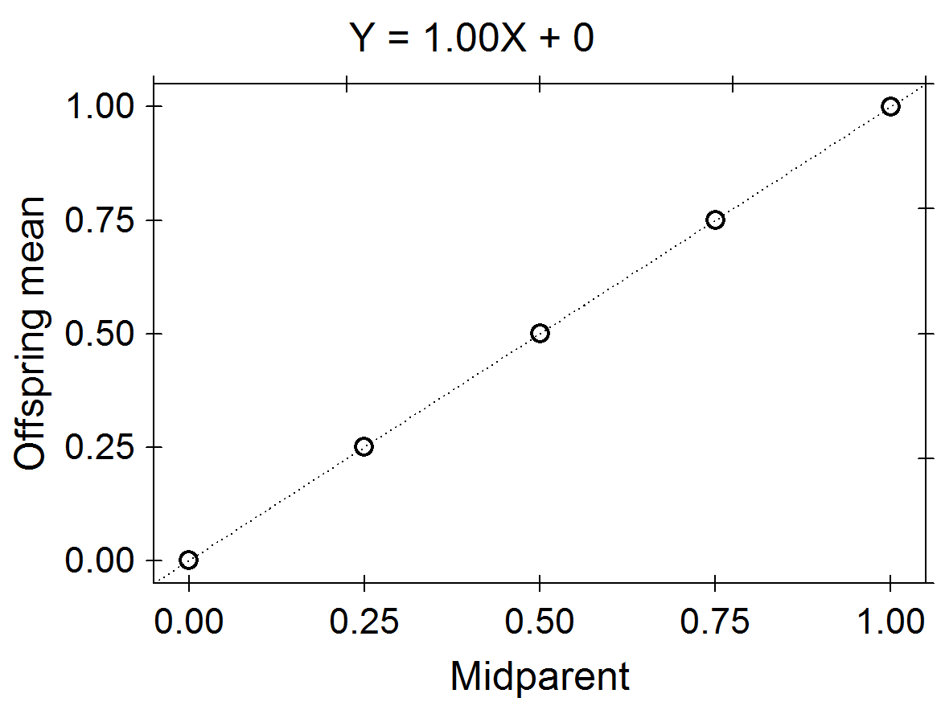
Example 1: h² from a Parent-offspring regression
Family
3
Family
2
Greener
Family
1
Greener

Slide 15
Example 1: h² from a Parent-offspring regression
Family
3
Slope
= Rise/Run
= Y/X
Family
2
Rise (Y)
Family
1
Run (X)

Slide 16
Example 1: h² from a Parent-offspring regression
Family
3
Slope
= Rise/Run
= Y/X
= 0.5/0.5
= 1.0
Family
2
Rise (Y)
Family
1
Run (X)

Slide 17
h² from a Parent-offspring regression…
Example 2: h² from a Parent-offspring regression
0.40
0.30
0.20
0.10
0.00
Family
3
Slope
= Rise/Run
= Y/X
= 0.2/0.5
= 0.4
Family
2
Y
Family
1
X

Slide 18
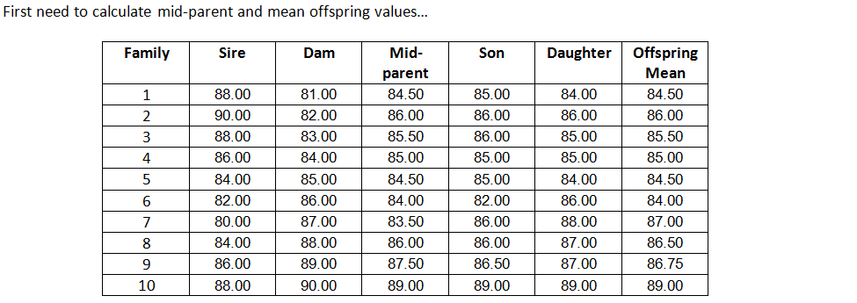
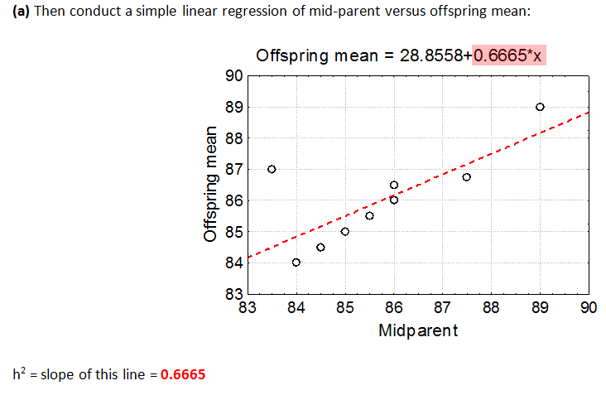

Slide 19
Slope
= Rise/Run
= Y/X
= ~2/3
= 0.66667
Y
X

Slide 20
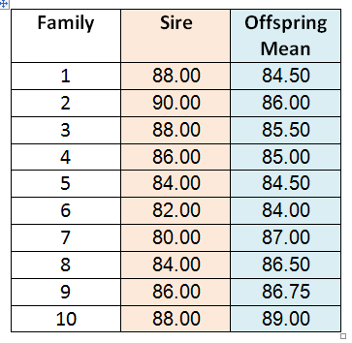
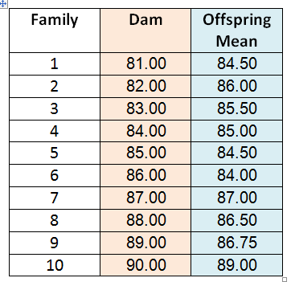

Slide 21
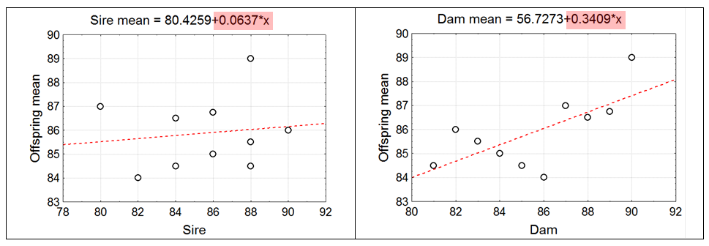

Slide 23
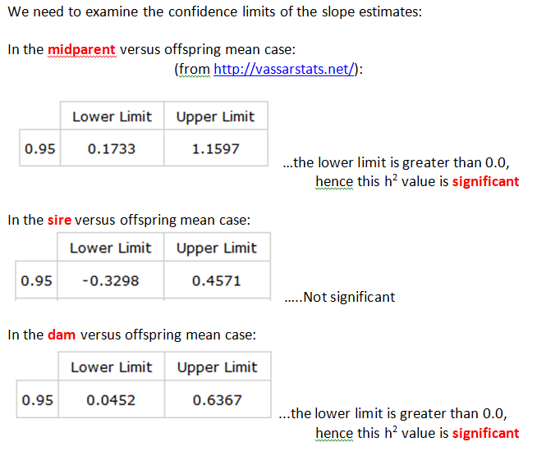
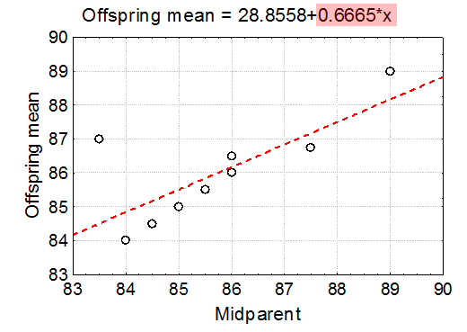

Slide 24
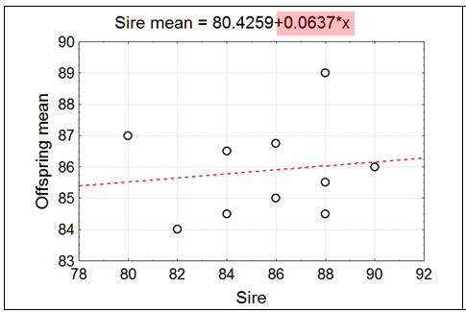

Slide 25
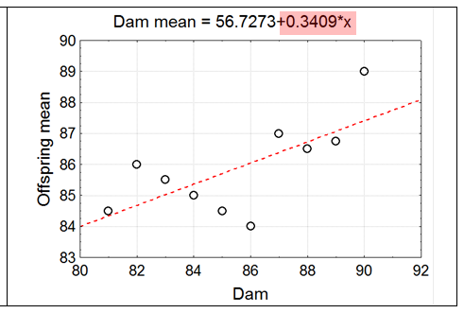

Slide 26
REVISION PROBLEMS

Slide 27
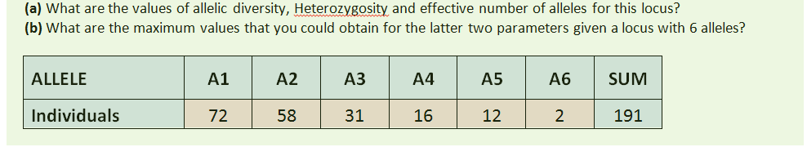
1. Allelic variation was obtained at a single locus
ALLELE | A1 | A2 | A3 | A4 | A5 | A6 | SUM
Observations | 72 | 58 | 31 | 16 | 12 | 2 | 191
Observations
For part (a) estimate Expected H (under H-W)

Slide 28
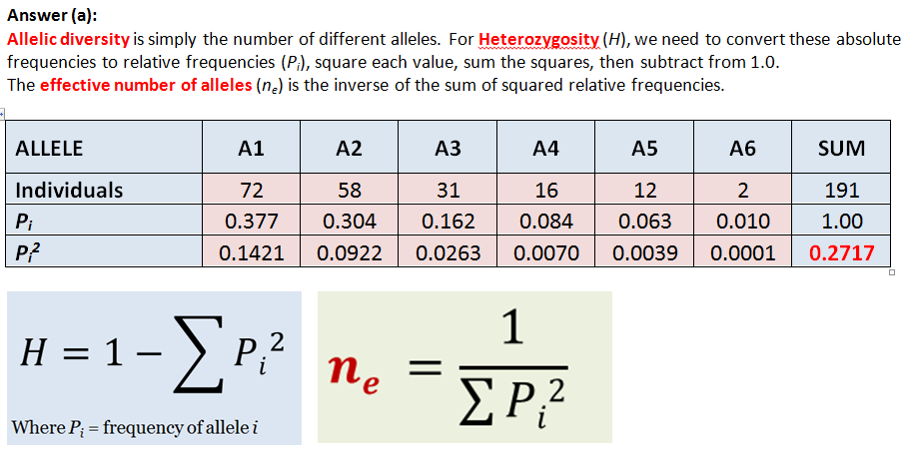
ALLELE | A1 | A2 | A3 | A4 | A5 | A6 | SUM
Observations | 72 | 58 | 31 | 16 | 12 | 2 | 191
Observations
Observations

Slide 29
ALLELE | A1 | A2 | A3 | A4 | A5 | A6 | SUM
Observations | 72 | 58 | 31 | 16 | 12 | 2 | 191
Observations
Observations
Observations
A = 6 / 1
= 6
H = 1- 0.2717
= 0.7283
N_{e} = 1 / 0.2717
= 3.6805

Slide 30
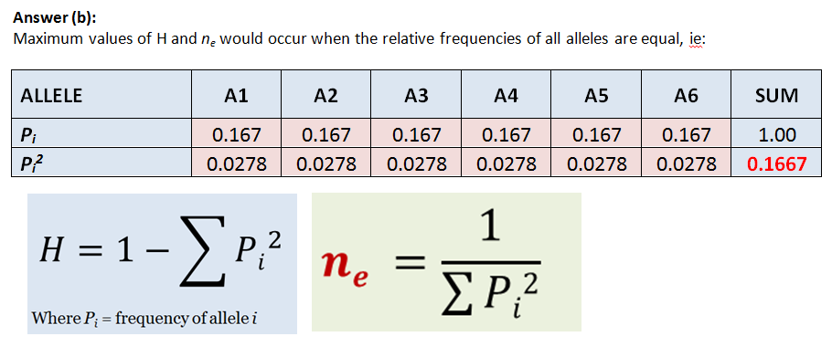
1. Allelic variation was obtained at a single locus
ALLELE | A1 | A2 | A3 | A4 | A5 | A6 | SUM
Observations | 72 | 58 | 31 | 16 | 12 | 2 | 191
Observations

Slide 31
ALLELE | A1 | A2 | A3 | A4 | A5 | A6 | SUM
Observations | 72 | 58 | 31 | 16 | 12 | 2 | 191
Observations
A = 6 / 1
= 6
H = 1- 0.1667
= 0.8333
N_{e} = 1 / 0.1667
= 5.9988

Slide 32
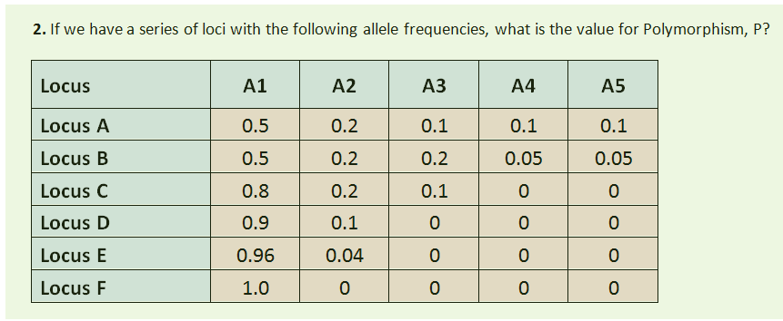
Answer P = 5/6 = 0.83

Slide 33
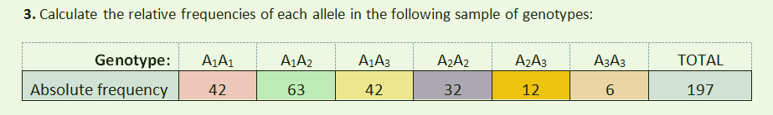
3. Do the genotype frequencies deviate significantly from H-W equilibrium?
Frequency

Slide 34
3. Do the genotype frequencies deviate significantly from H-W equilibrium?
Frequency
Step 1: Allele frequencies
A₁: p = 0.48
A₂: q = 0.35
A₃: r = 0.17

Slide 35
3. Do the genotype frequencies deviate significantly from H-W equilibrium?
Frequency
Step 1: Allele frequencies
A₁: p = 0.48
A₂: q = 0.35
A₃: r = 0.17
Step 2: H-W expected genotype frequencies
Genotype | A₁A₁ (p²) | A₁A₂ (2pq) | A₁A₃ (2pr) | A₂A₂ (q²) | A₂A₃ (2qr) | A₃A₃ (r²)
Expected frequency | 0.2304 | 0.336 | 0.1632 | 0.1225 | 0.119 | 0.0289

Slide 36
3. Do the genotype frequencies deviate significantly from H-W equilibrium?
Frequency
Step 1: Allele frequencies
A₁: p = 0.48
A₂: q = 0.35
A₃: r = 0.17
Step 2: H-W expected genotype frequencies
Genotype | A₁A₁ (p²) | A₁A₂ (2pq) | A₁A₃ (2pr) | A₂A₂ (q²) | A₂A₃ (2qr) | A₃A₃ (r²)
Expected frequency | 0.2304 | 0.336 | 0.1632 | 0.1225 | 0.119 | 0.0289
Step 3: H-W expected genotype counts (absolute frequencies)
Genotype | A₁A₁ (p²) | A₁A₂ (2pq) | A₁A₃ (2pr) | A₂A₂ (q²) | A₂A₃ (2qr) | A₃A₃ (r²)
Expected counts | 45.39 | 66.19 | 32.15 | 24.13 | 23.443 | 5.69

Slide 37
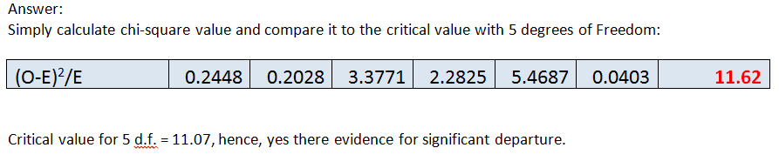
3. Do the genotype frequencies deviate significantly from H-W equilibrium?
Frequency
Step 1: Allele frequencies
A₁: p = 0.48
A₂: q = 0.35
A₃: r = 0.17
Step 2: H-W expected genotype frequencies
Genotype | A₁A₁ (p²) | A₁A₂ (2pq) | A₁A₃ (2pr) | A₂A₂ (q²) | A₂A₃ (2qr) | A₃A₃ (r²)
Expected frequency | 0.2304 | 0.336 | 0.1632 | 0.1225 | 0.119 | 0.0289
Step 3: H-W expected genotype counts (absolute frequencies)
Genotype | A₁A₁ (p²) | A₁A₂ (2pq) | A₁A₃ (2pr) | A₂A₂ (q²) | A₂A₃ (2qr) | A₃A₃ (r²)
Expected counts | 45.39 | 66.19 | 32.15 | 24.13 | 23.443 | 5.69
Step 4: H-W expected genotype counts (absolute frequencies)

Slide 38
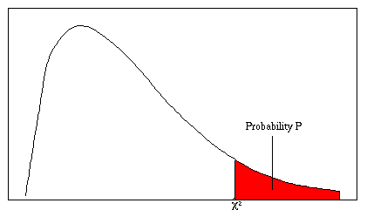
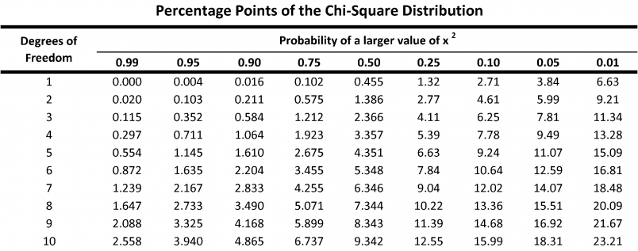
Chi squared table

Slide 39
3. Do the genotype frequencies deviate significantly from H-W equilibrium?
Frequency
3
Critical value for 3 d.f. = 7.81, hence yes there is evidence for significant departure

Slide 40
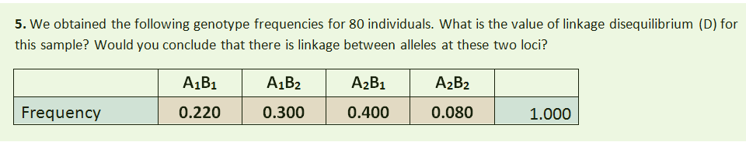
gametic

Slide 41
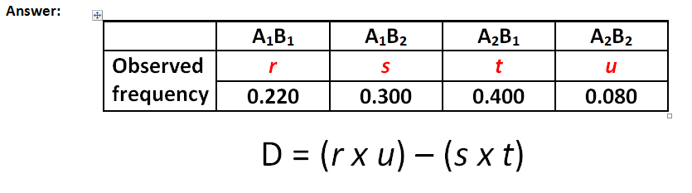
gametic
D = (0.22 x 0.08) – (0.3 x 0.4)
= 0.0176 – 0.12
= -0.1024

Slide 42
gametic
Therefore, If the observed gametic counts differ significantly from the expected gametic counts, we conclude there is linkage disequilibrium.

Slide 43
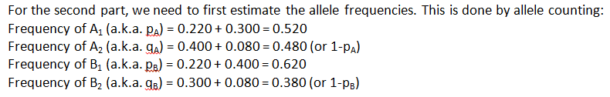
gametic

Slide 44
At equilibrium alleles are randomly assorted.
Rules of probability apply:
When we are looking at the probability of either A OR B occurring, we ADD. Counting alleles corresponds to asking if alleles are occurring in either of the two genotypes.
When looking at probability of both A AND B occurring we MULTIPLY.
The probability of two alleles occurring in a single particular genotype. (r,u,s,t)

Slide 45

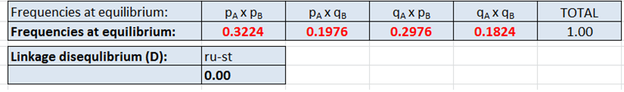
gametic
Frequencies at equilibrium | A₁ x B₁ | A₁ x B₂ | A₂ x B₁ | A₂ x B₂ | Total

Slide 46
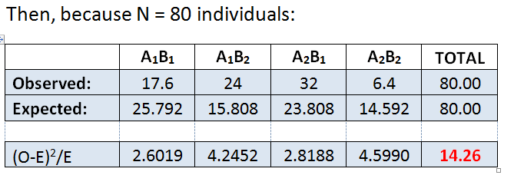
gametic
Frequencies at equilibrium | A₁ x B₁ | A₁ x B₂ | A₂ x B₁ | A₂ x B₂ | Total
Degrees of Freedom = 2 – 1 = 1
Two outcome categories: recombinant and parental gamete types

Slide 47
Chi squared table
Because our χ² value (14.26) is larger than the table value (3.84), P < 0.05.

Slide 48
gametic
Because P < 0.05, we conclude there is a significant difference between observed gametic counts and the gametic counts that would be expected at equilibrium.
Therefore, the observed frequencies are at disequilibrium.

Slide 49
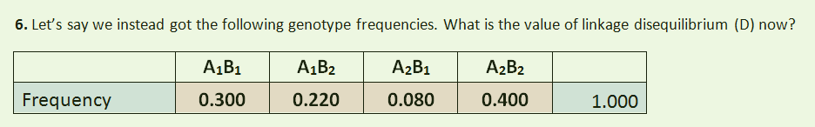
gametic

Slide 50
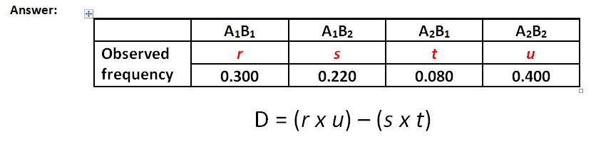
gametic
D = (0.3 x 0.4) – (0.22 x 0.08)
= 0.12 – 0.0176
= 0.1024

Slide 51
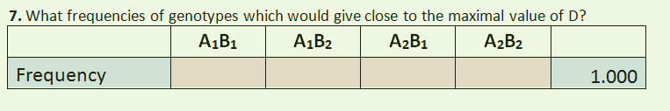
7. What frequency of gametes would give the maximal value of D?

Slide 52
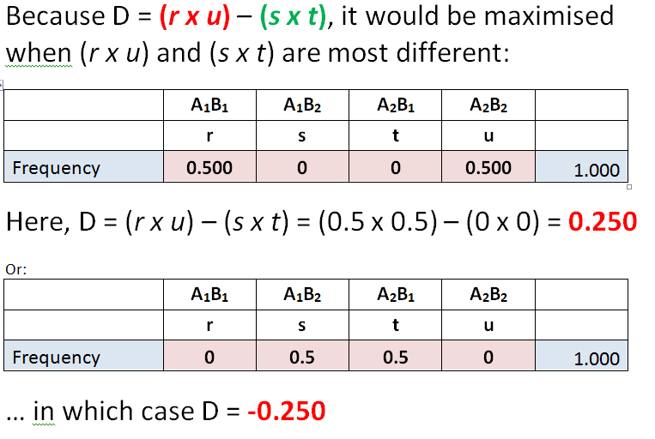
7. What frequency of gametes would give the maximal value of D?
gametes

Slide 53
7. What frequency of gametes would give the maximal value of D?
gametes

Slide 54
7. What frequency of gametes would give the maximal value of D?
gametes

Slide 55

!! GOOD LUCK FOR THE TEST !!
Open book – prepare your own formula sheet
If you have any questions please don’t hesitate to ask. My details are on ilearn.

